Slide 1

A Next Generation University Press: UCL Press as a model for Open Science publishing
Dr Paul Ayris
Pro-Vice-Provost (LCCOS)
E-mail: p.ayris@ucl.ac.uk
Twitter: @ucylpay

Slide 2

Content
Open Science – a view from LERU
Future of Scholarly Publishing
Next-Generation Metrics
Next Steps
Plaster Relief by John Flaxman,
Flaxman Gallery, UCL

Slide 3
European Commission: Open Science Policy Platform – 8 pillars of Open Science
Future of Scholarly Communication
EOSC (European Open Science Cloud)
FAIR Data
Skills
Research Integrity
Rewards
Altmetrics
Citizen Science

Slide 4

The role of the Funder
For research, research funders have set the agenda
Plan S from Science Europe is the latest attempt to deliver a meaningful transition to immediate Open Access
A kick to Open Access that was badly needed

Slide 5
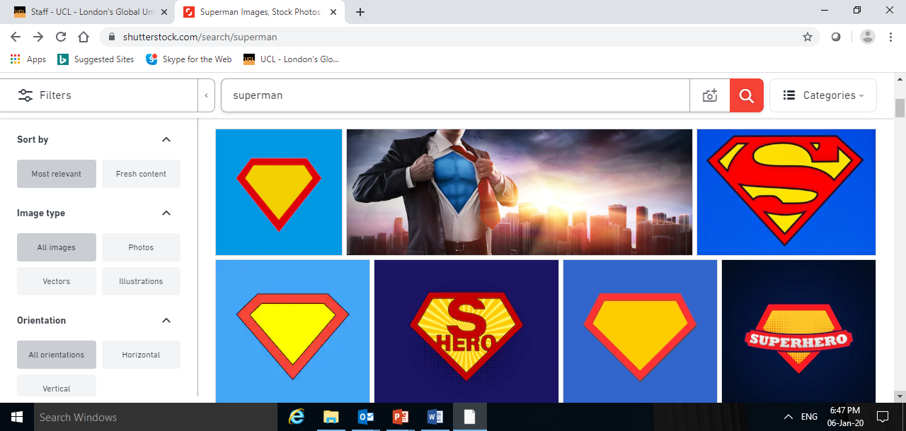
Plan S
LERU
JISC
UCL
Press
UCL Discovery
How does Plan S work for UCL?
Transformative Agreements
Alternative Publishing Platforms
Repository development

Slide 6
Plan S
Issues for universities
Positives
  Timeframes
  The role of Green OA
Challenges
  Cost – LERU universities do not want to pay more than now
  Define a transformative agreement
  A European solution only?
  Less than 5% of global research covered…

Slide 7
Plan S - a global solution?
AmeliCA
Open Access strategies, such as Plan S, should be discussed globally. We are still waiting to know how cOAlition S is planning to support and engage with other OA business models. We would like to see Plan S not as a narrow program to replace the pay to read model with a pay to publish model, but as a more comprehensive solution to achieve OA
  For link, see here

Slide 8
Benefits of an OA University Press
Taking publishing back into the university system – the university supports the entire research life cycle
Challenge the prevailing scholarly publishing model – issue of low dissemination
Support for OA to AHSS outputs, which receive less funding than STEM
Social impact: research available to the public and policy makers
Global impact: outputs reach regions in which research is unavailable or unaffordable
Motivation for academics: they want their research to be widely read
Added reputational value of a university press, through global dissemination, publicity, reviews
Consistent with Open Science agenda
Opportunities for integration of research and learning

Slide 9
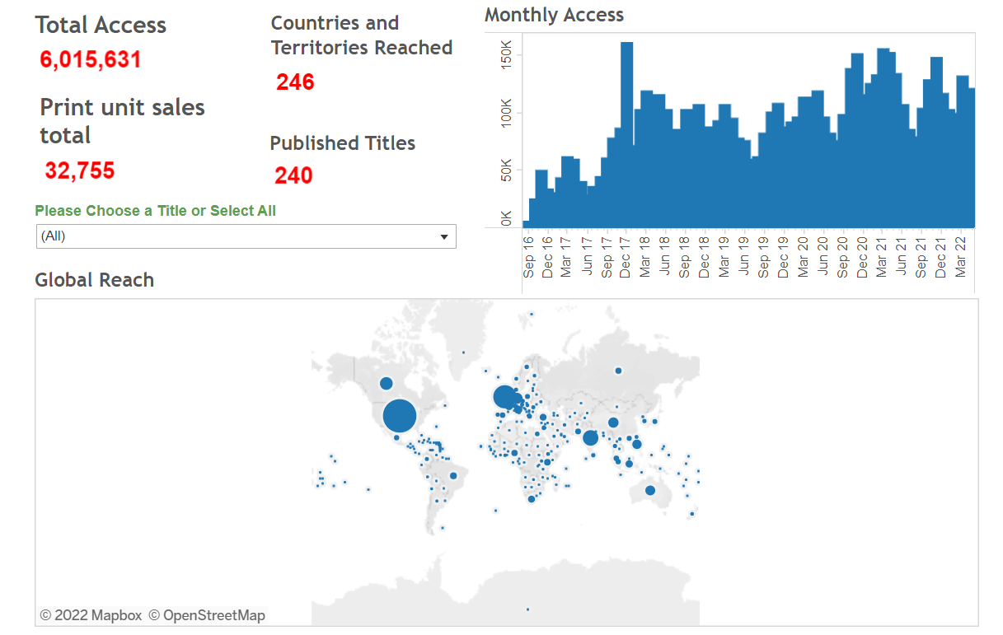
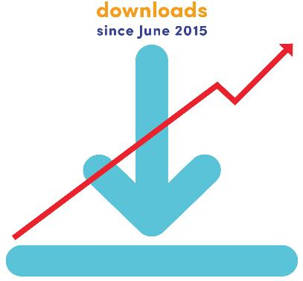
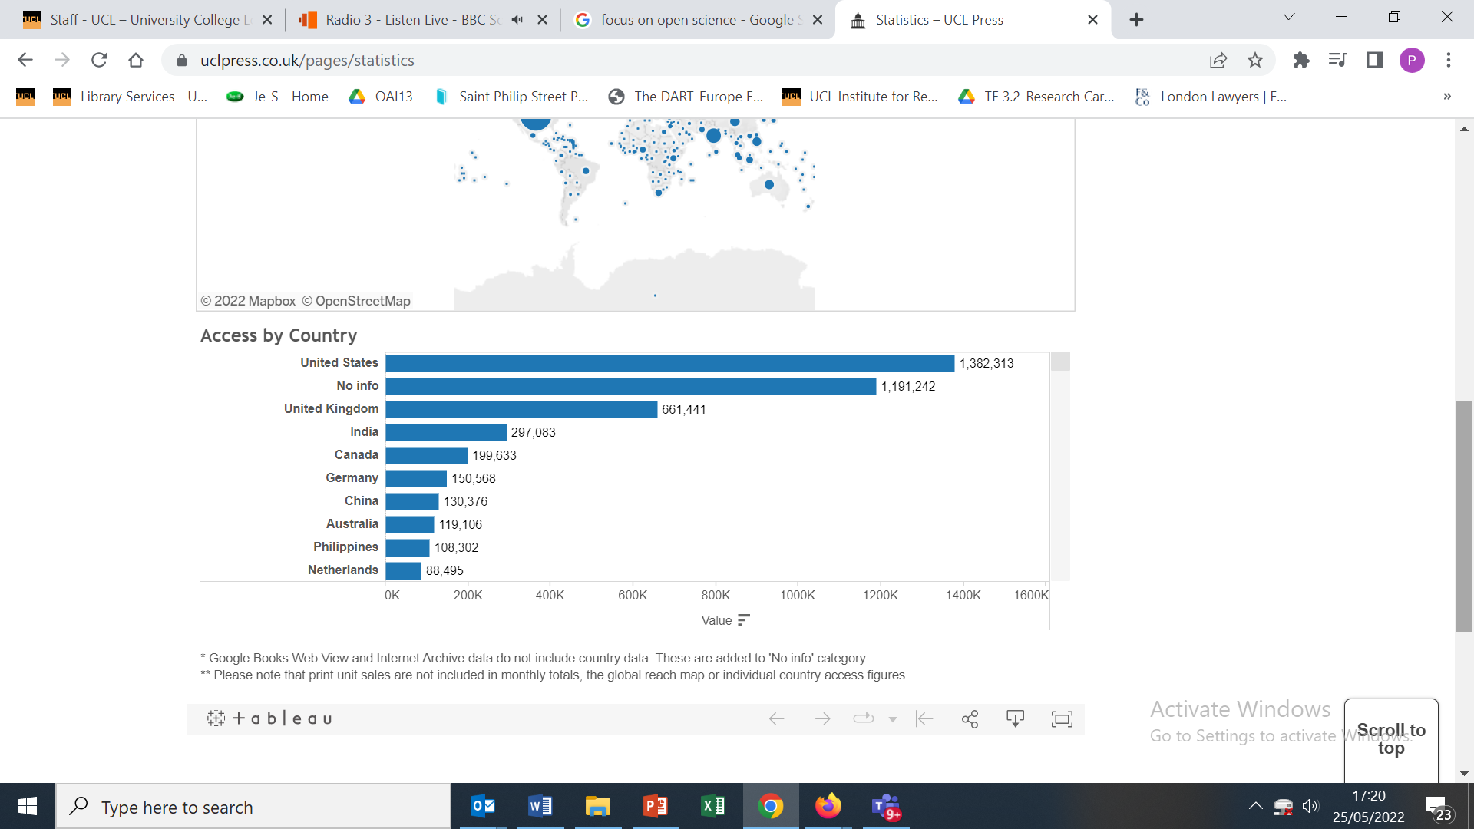
Use & Impact
6 million+
246 countries

Slide 10

UCL Press offers publishing services
Dublin City University is the first university to buy publishing services from UCL
All outputs to be branded as Dublin City University Press
All enquiries welcomed
https://www.uclpress.co.uk/

Slide 11
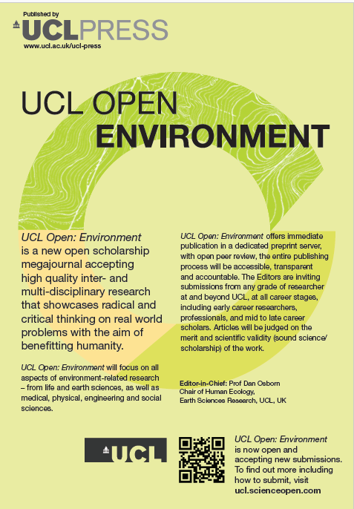
Megajournal platform, UCL Open, launched 31 January 2019
Author revises: new version posted alongside all versions
Article typeset/ copyedited & published in journal (assigned a journal DOI) - links to
version & review history on pre-print server
.Author
submits
Editor
assess
Paper posted online to pre-print server
Editor comments
(i.e. revision requirements)
Editor
accepts version
Author
pays APC
All versions and review reports assigned a
pre-print DOI
Open reviewer reports posted alongside paper (assigned a
pre-print DOI)
UCL Open: Environment - https://ucl-about.scienceopen.com/
Inter-disciplinary and cross-disciplinary content
Fast turn-around times being planned

Slide 12
Content
Open Science – a view from LERU
Future of Scholarly Publishing
Promotions/Rewards & Next-Generation Metrics
Next Steps
Plaster Relief by John Flaxman,
Flaxman Gallery, UCL

Slide 13

Next-Generation Metrics
UCL Bibliometrics Policy signed off on 27 Feb. 2020
3 years in the development
Aligned with DORA and Leiden Manifesto
Discourages the use of Journal Impact Factors as a surrogate for Quality
Identifies that H-Index discriminates against Early Career Researchers who have taken a family break

Slide 14
Next-Generation Metrics
Policy identifies 11 principles on the successful use of metrics, with copious guidance
Numerical metrics are simply an adjunct to the academic assessment of a research output through reading it
China has (Feb. 2020) announced that this is to be its official policy for research evaluation/reward going forward
  https://www.universityworldnews.com/post.php?story=20200226122508451
UCL reactions
‘Fabulous’
‘Sector-leading’

Slide 15

Conclusion
Open Access publishing is a blueprint for the university of the 21st century
Benefits are obvious
Challenges are not easy to address
Not a given that Open Access will be the default way to proceed
Universities have to make a choice
UCL Student Centre, opened 18/2/19
Over to you to decide…

